Slide 1

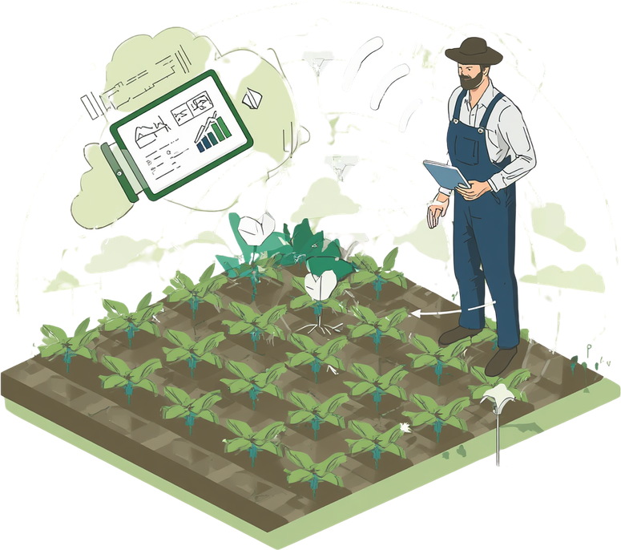
Core Solutions
Smart Agriculture Irrigation System
Real-Time Data Engineering Pipeline for Smart Irrigation
Presented By
Esmail Alsyaghi

Slide 2





Project Overview
Water Scarcity Challenge
IoT Sensor Data Collection
Data Engineering Pipeline
Agriculture in Yemen relies on efficient irrigation amid water scarcity and rapidly changing weather conditions.
Collect real-time sensor and weather data via IoT devices deployed across irrigation fields.
Process data with a modern pipeline, predict irrigation needs using Machine Learning, and visualize insights in Grafana dashboards.

Slide 3
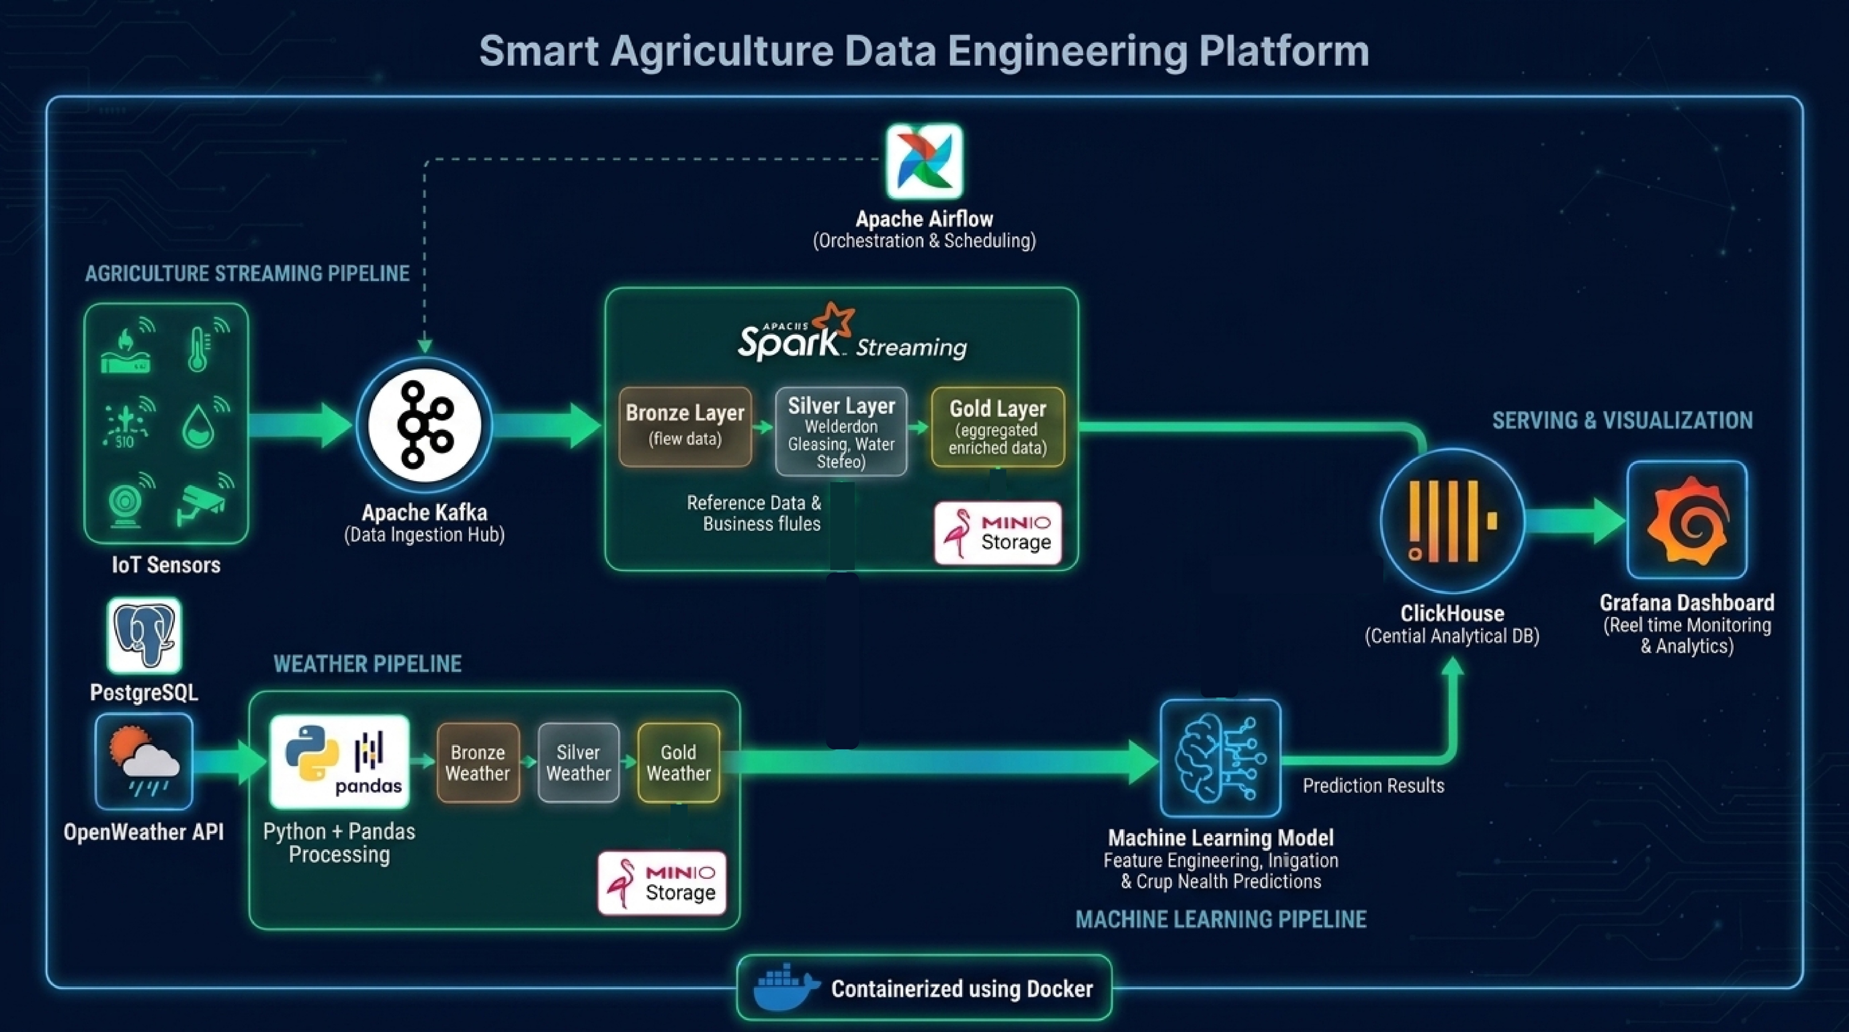

Slide 4
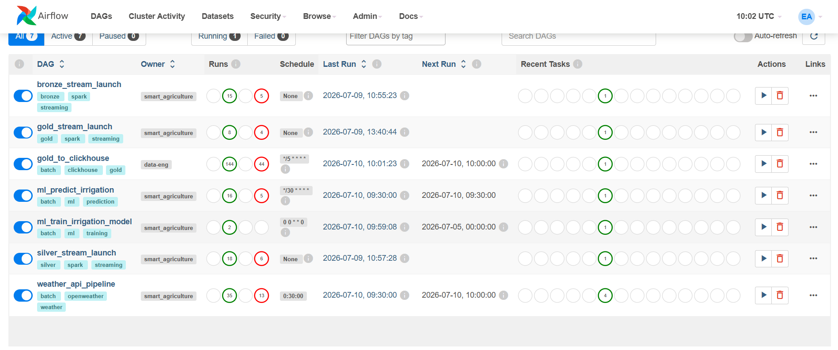

Slide 5
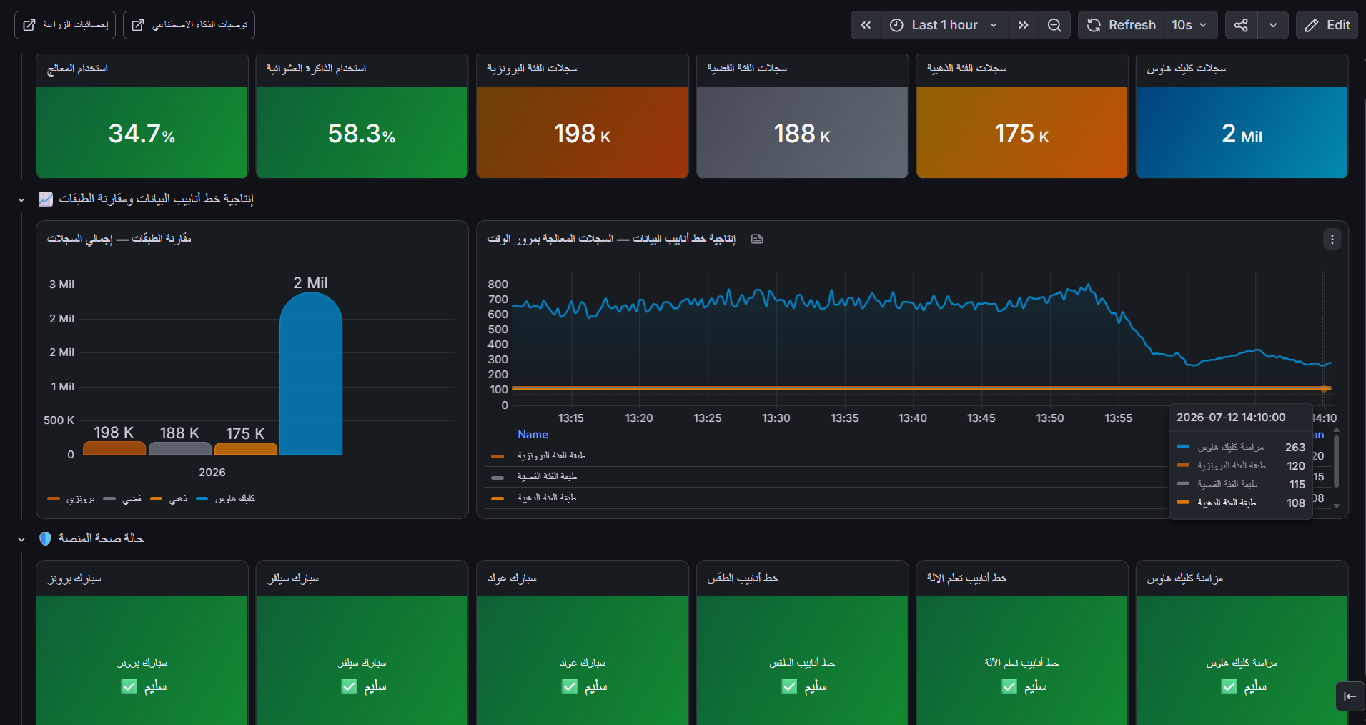

Slide 6
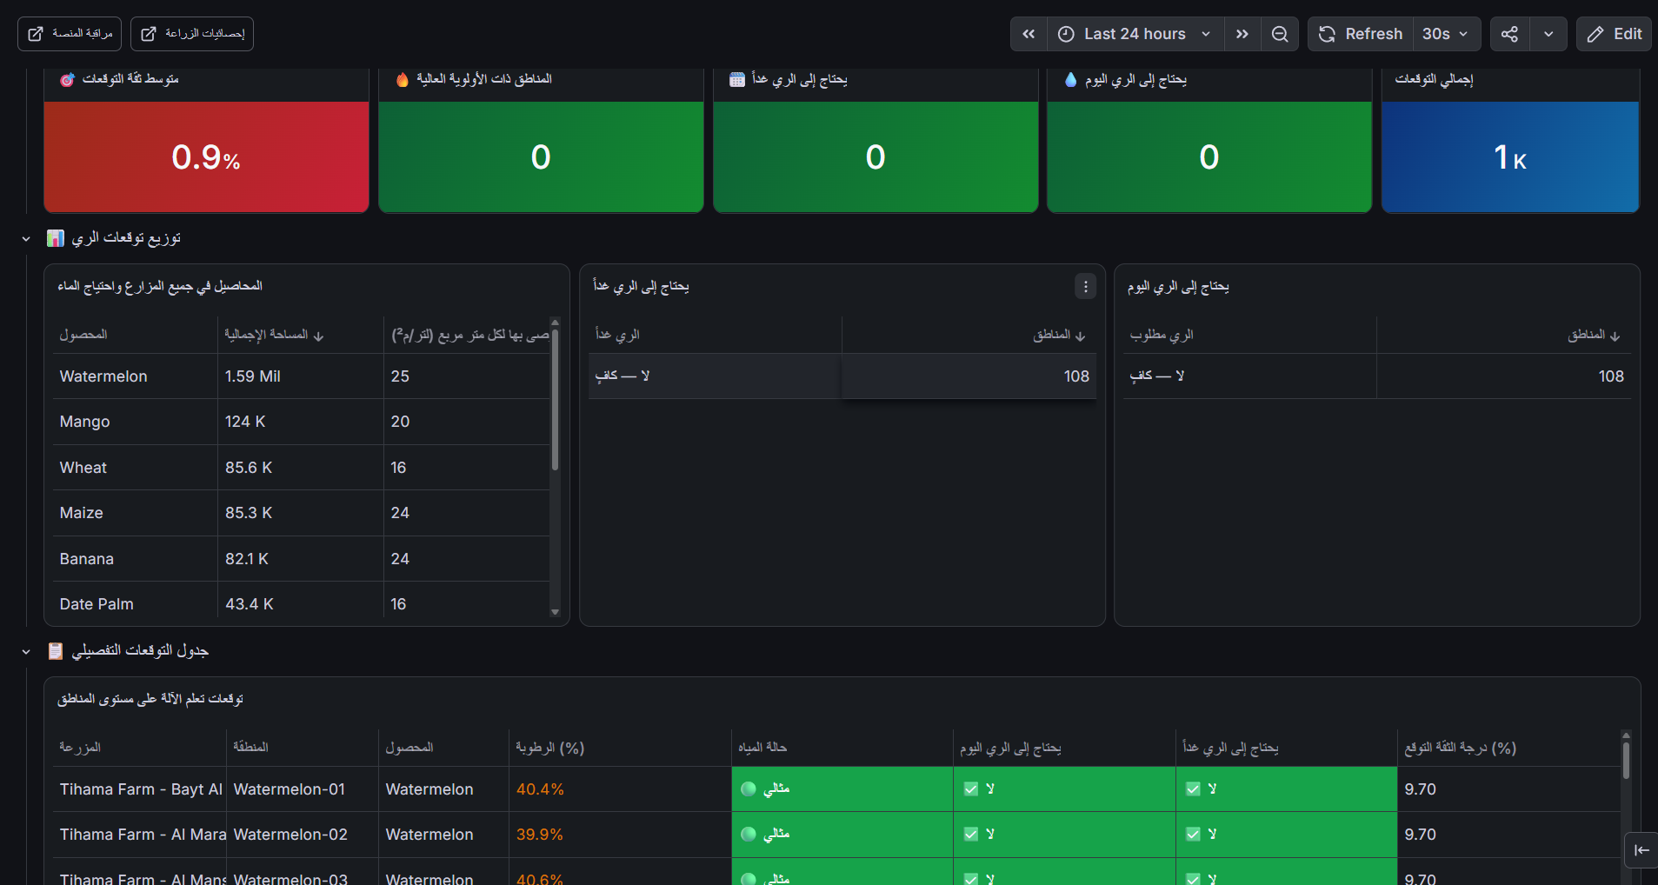

Slide 7
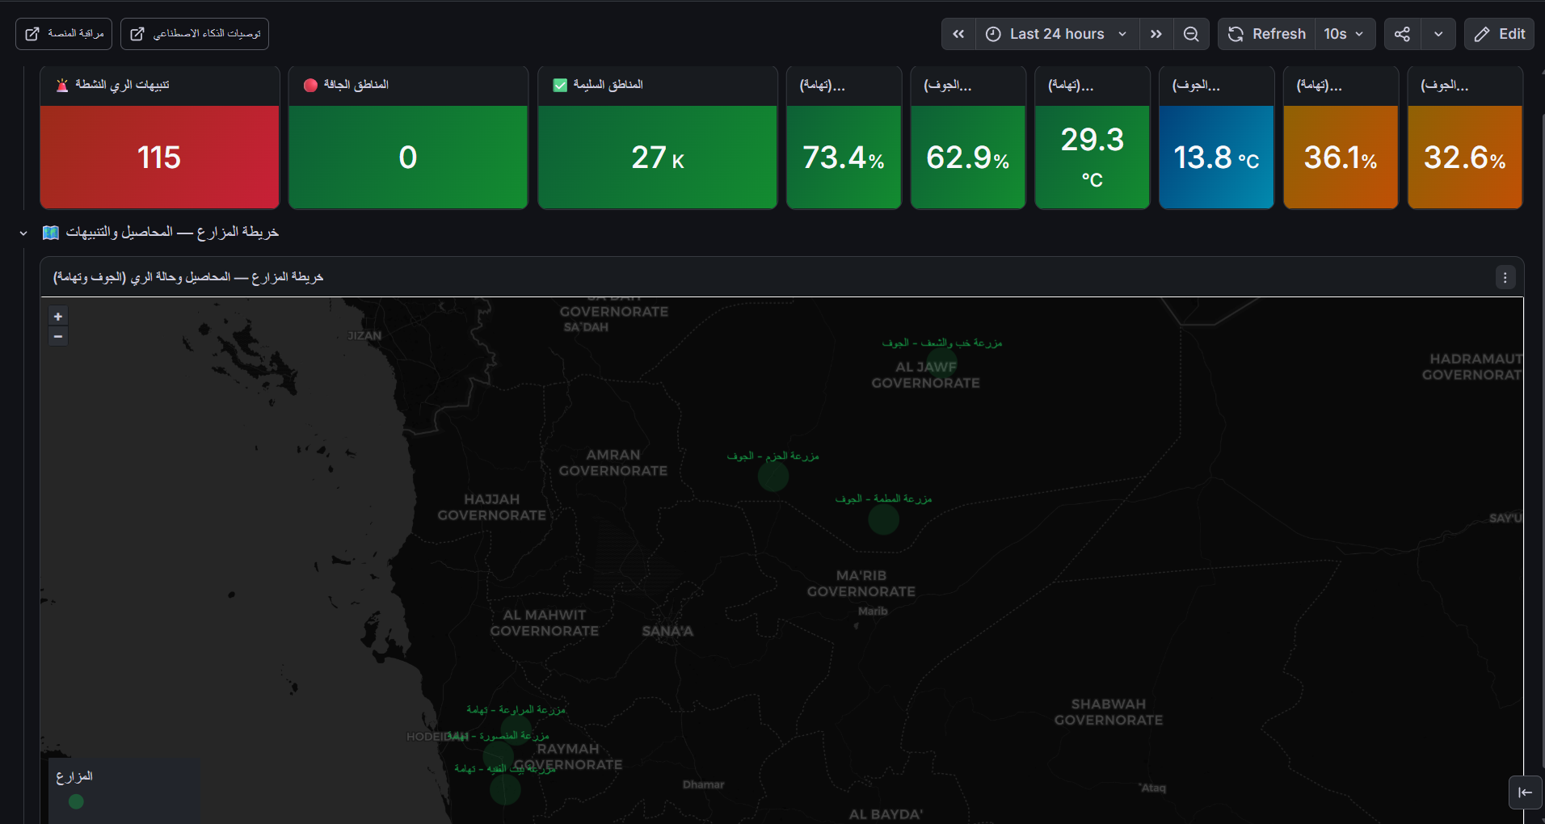

Slide 8


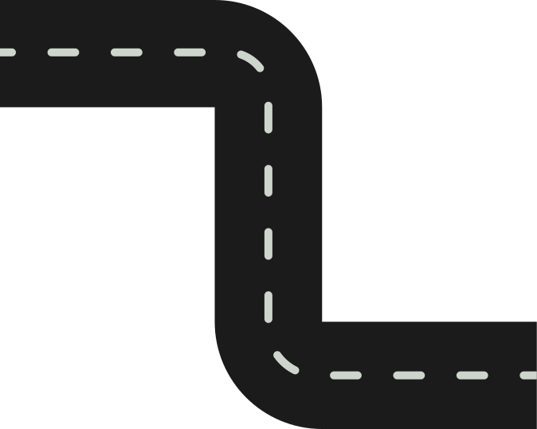





Questions?
We welcome your questions, feedback, and ideas on the Smart Agriculture Irrigation System.
Let's Connect
Reach out to discuss how real-time IoT data pipelines can transform irrigation and water management.
What's Next
Thank You
Expanding ML models, integrating more sensors, and scaling the pipeline for broader agricultural regions.

